Slide 1


AI in the Creative Industries: Opportunities and Challenges
This presentation explores the intersection of artificial intelligence and the creative industries, examining the opportunities and challenges that AI presents for artists, musicians, writers, and other creative professionals.
by Akshay Damodar

Slide 2
The Rise of Generative AI: Disrupting Creative Work
Generative AI
Disruption
Generative AI models are capable of creating new content, from paintings to music to written text, based on patterns learned from vast datasets.
The rapid development of these models is revolutionizing creative workflows, challenging traditional notions of authorship and creativity.

Slide 3
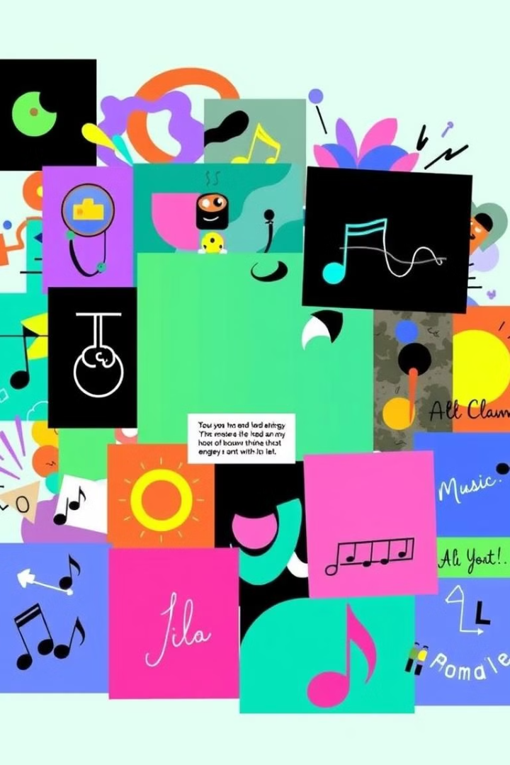
AI-Generated Art, Music, and Writing: Real-World Case Studies
Art
Music
AI systems are creating art that pushes boundaries and inspires new forms of aesthetic expression.
AI composers are creating original scores and generating new music styles, impacting the music industry.
Writing
AI-powered writing assistants are helping authors generate ideas, write drafts, and even compose complete novels.

Slide 4



Balancing Augmentation and Automation: The Importance of Human Creative Control
Human Role
AI Limitations
AI tools can augment human creativity, providing inspiration, feedback, and technical assistance.
AI models lack the emotional intelligence and nuanced understanding that are essential for truly original creative work.

Slide 5
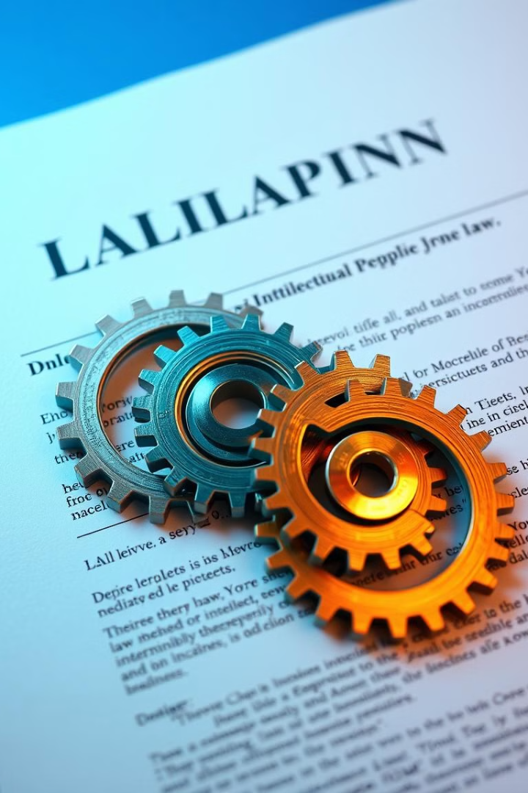
Intellectual Property and Ownership: Navigating the Legal Landscape
1
AI-generated content raises questions about ownership and copyright.
2
Legal frameworks are being challenged as AI systems become more sophisticated.
3
Clarity is needed to protect the rights of both human creators and AI developers.

Slide 6
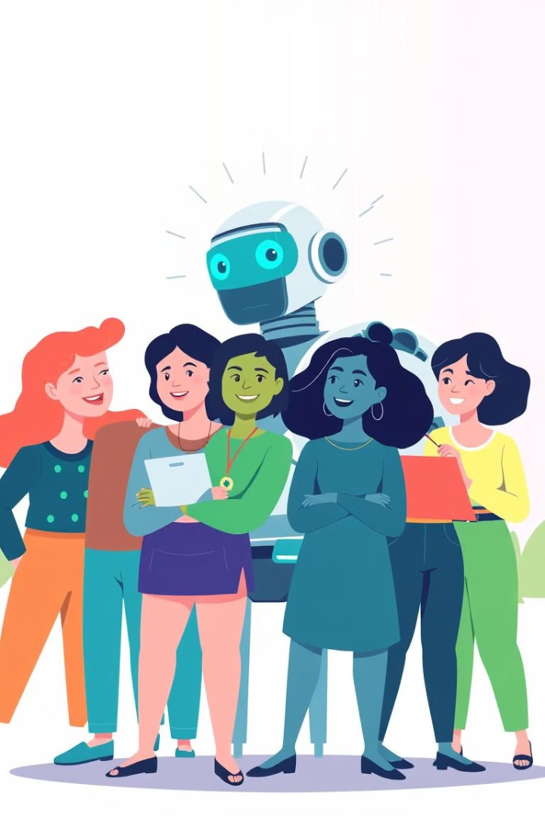



Job Displacement and Economic Impact: Addressing Workforce Concerns
AI-powered tools may automate certain creative tasks, leading to concerns about job displacement.
Upskilling and reskilling programs are crucial to prepare workers for the changing job market.
Policies that foster collaboration between humans and AI can mitigate negative economic impacts.

Slide 7



Authenticity and Emotional Resonance: The Limits of AI-Generated Content
1
Emotional Connection
2
Meaning
3
Authenticity
While AI can generate technically impressive content, it struggles to capture the genuine emotions and personal experiences that make human art powerful.

Slide 8
Ethical Considerations: Preventing Misuse and Maintaining Trust
1
Transparency
2
Accountability
3
Bias Mitigation
It's essential to develop ethical guidelines and safeguards to prevent the misuse of AI in creative industries.

Slide 9
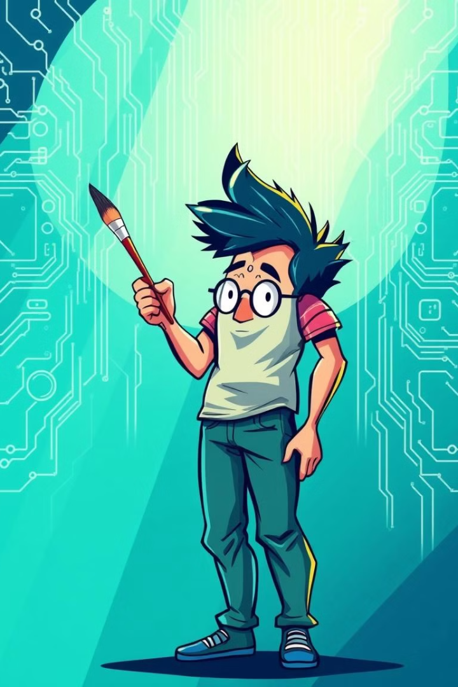
The Creative Industry's Fight Against AI: Lessons for Other Sectors
1
2
Innovation
Regulation
The creative industries are pushing the boundaries of AI technology, leading to advancements that impact other sectors.
The debate surrounding AI in the creative industries can inform regulatory frameworks in other fields.

Slide 10


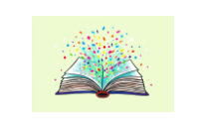

The Path Forward: Shaping a Balanced and Responsible AI Future
By fostering responsible innovation, promoting ethical use, and ensuring human control over AI, we can shape a future where technology enhances creativity without diminishing human artistry.

